Slide 1
EXTRA SERVICE & OVERTIME PROCESS
Financial Management Office
01/03/2022

Slide 2
AGENDA
Extra Service – Certificated Staff Only
  What is extra service & who is eligible to receive
  Activity Types
  SAP funding
  Approval Process
  Required documents e.g. extra service spreadsheet and pay agreement
  Timeliness in processing
  Rate of Pay (until further notice)
ESSER Extra Service
  Transportation
  Before/After Care (Judy King)
Overtime – Non-Exempt Staff (hourly)
  Who qualifies
  40 hour a week rule
  Kronos approval
  Rate of pay (until further notice)
Exceptions
  Metal Detector
  Breakfast Program
Demonstration
  Extra Service Spreadsheet
  Pay Agreement
Q/A Session

Slide 3
EXTRA SERVICE - Certificated
What is Extra Service Pay?
Extra Service pay is used to pay certificated employees for time worked outside of the normal workday or contract date.
IMPORTANT: If an employee does not have the additional hours documented in Kronos they will not receive the extra service pay, even if it is approved by the Principal and Finance Management Office.
Certificated employees only eligible include (but not limited to):
  Teachers
  Substitute teacher (teacher of record)
  Nurses
  Counselors
  Social Worker
  Academic Instructional Coaches (AIC)

Slide 4
EXTRA SERVICE - Certificated
Who is NOT eligible for Extra Service Pay?
Non-exempt employees are NOT eligible for Extra Service pay.
  Non-exempt employees are eligible for overtime via KRONOS
Principals, Assistant Principals, Administrators and eight hour a day employees are NOT eligible for Extra Service Pay

Slide 5
EXTRA SERVICE ACTIVITY TYPES
Activity Type Code | Activity Type | Extra Service Object Code | Frequency- Spreadsheet
0500 Athletic Coaches | Extra Service Payment | 613101 Extra Service Pay | Semester
0507 Textbook Xservice | Extra Service Payment | 613101 Extra Service Pay | As the activity occurs
0509 Homebound Inst. | Extra Service Payment | 613101 Extra Service Pay | Semester
0511 Department Head | Extra Service Payment | 613101 Extra Service Pay | Semester
0512 After School | Extra Service Payment | 613101 Extra Service Pay | Monthly
0513 Adult Basic Ed | Extra Service Payment | 613101 Extra Service Pay | Semester
0514 Metal Detector | Extra Service - Security | 613103 OT Cont Sub Tea | Semester
0516 Title 1 | Extra Service Payment | 613101 Extra Service Pay | Monthly
0518 Extra Service | Extra Service Payment | 613101 Extra Service Pay | As the activity occurs or Monthly
0523 Tutoring | Extra Service Payment | 613101 Extra Service Pay | Monthly
0524 Professional Development | Professional Development | 613102 Extra Sercice - PD | As the activity occurs
0561 Community Schools - 1 | Extra Service Payment | 613101 Extra Service Pay | Semester
0583 Breakfast Program | Extra Service Payment | 613101 Extra Service Pay | Semester
0595 After School Supervision | Extra Service Payment | 613101 Extra Service Pay | Monthly
0596 Before School Care supervision | Extra Service Payment | 613101 Extra Service Pay | Monthly
0597 Homeworks Program | Extra Service Payment | 613101 Extra Service Pay | Semester
Notes:
The Extra Service Activity Type Codes must be in alignment with the extra that is being performed.

Slide 6
SAP FUNDING
SAP Funding is to be used on the Extra Service Spreadsheet. If you are not sure of how to find the SAP Funding, please reach out to your Finance Analyst for further assistance
NOTE: The Finance Management Office is working on providing a new spreadsheet that will use the BusinessPLUS account code structure.
BusinessPLUS Funding is used to confirm budget availability
Example:
BP Account Code: 250-1251-613101-2080-451020-22
SAP Info (to be use for Extra Service Spreadsheet)
    Fund: 290
    Cost Center: 30377-35
    Grant: T1SI-AZ-2122
Notes:
The Extra Service Activity Type Codes must be in alignment with the extra that is being performed.

Slide 7
EXTRA SERVICE APPROVAL PROCESS
School Completes, Extra Service Spreadsheet and Pay agreement
Network Superintendent review and approves
Finance Analyst approves and forward to Payroll
Payroll approves and uploaded into SAP
Time can now be entered into SAP by the timekeeper
Step 1: The schools must complete the extra service spreadsheet and signed pay agreement and forward to the Network Superintendent (NS) for additional approval
Step 2: The NS will review, approve, and sign the extra service pay agreements. Electronic approval is acceptable for NS ONLY. Both signatures (Employee and Principal) must be on the pay agreement when sent to the Financial Management Office
Step 3: The spreadsheet and pay agreement are then forwarded to the FinMgmtOfc@slps.org for processing. Your assigned Financial Analyst will review and if there are no additional information needed or errors, it will be forwarded to the payroll dept for final approval.
Step 4: The Payroll department approves and uploads the spreadsheet into SAP. Employees cannot be paid unless there is a record in SAP
Step 5: Employees extra service hours can now be entered into SAP by the timekeeper
Notes:
Prior to submitting Extra Service Requests, verify that funds are available on the budget line (including benefits for 621102-Social Security (7.65%), and 626101-Worker’s Compensation (2%) corresponding to the request). • Extra Service Spreadsheets MUST be submitted electronically in order to upload into SAP; employees cannot be paid unless there is a record in SAP.

Slide 8
EXTRA SERVICE DOCUMENTS
In order to process Extra Service pay in a timely manner the following documents must be submitted:
Completed Extra Service Spreadsheet – Excel version only
Completed and signed Extra Service Pay Agreement
Any additional information requested by the Financial Management or Payroll Offices needed in order to be approve
The most updated Extra Service Spreadsheet & Pay agreement can be found on FMO website Financial Management Office Webpage
Notes:
Prior to submitting Extra Service Requests, verify that funds are available on the budget line (including benefits for 621102-Social Security (7.65%), and 626101-Worker’s Compensation (2%) corresponding to the request). • Extra Service Spreadsheets MUST be submitted electronically in order to upload into SAP; employees cannot be paid unless there is a record in SAP.

Slide 9
EXTRA SERVICE TIMELINESS
For Extra Service to be processed by the end of the pay period, the spreadsheet will need to be confirmed by the Financial Management Office and uploaded by Payroll the Monday prior to the end of the pay period.
  Example:
    Pay Period Ending 1/14/2022, Extra Service Spreadsheet due Monday 1/10/2022 for pay to be received on 1/21/2022
Payroll entry must be completed at the end of business every Friday, meaning your KRONOS and Extra Service entries are complete for the current work week
The grace period allowed on Monday morning of Payroll close is for last minute adjustments only!
Notes:
Prior to submitting Extra Service Requests, verify that funds are available on the budget line (including benefits for 621102-Social Security (7.65%), and 626101-Worker’s Compensation (2%) corresponding to the request). • Extra Service Spreadsheets MUST be submitted electronically in order to upload into SAP; employees cannot be paid unless there is a record in SAP.

Slide 10
EXTRA SERVICE RATE OF PAY/PLANNING PERIOD
Until further notice the extra service rate of pay has increased from $25.52 per hour to $40.00. However, the $25.52 rate must remain on the extra service spreadsheet and the $40.00 is systematically calculated behind the scenes.
The updated extra spreadsheet calculates the dollar amount based on $40.00 per hour. This is to help your location to budget accordingly.
Planning Period is for Teachers, Teacher’s Aides, and Assoc. Subs (subs who are the teacher of record) who have to give up their planning period to take over a class
  Planning Period Pay - $30/hr (For this fiscal year only)
  Put the hour inside of Kronos
Everyone in the building is not eligible for Planning Period because they are paid for by the hour. (e.g. Secretaries, Book Clerk Treasurers, ISS Monitors, FCS, Counselors, Social Workers) *This is not an inclusive list*
Notes:
Prior to submitting Extra Service Requests, verify that funds are available on the budget line (including benefits for 621102-Social Security (7.65%), and 626101-Worker’s Compensation (2%) corresponding to the request). • Extra Service Spreadsheets MUST be submitted electronically in order to upload into SAP; employees cannot be paid unless there is a record in SAP.

Slide 11
ESSER EXTRA SERVICE
Before/After Transportation Supervision
  There is a Microsoft Team created that includes a special extra service spreadsheet and processing instructions. This file should be submitted by pay period. Only Principals, Secretaries, and Book Clerk Treasures will have access to this MS Team if requested
Before and After School (Judy King)
Note: Until the Financial Management Office (FMO) receives confirmation of the approved ESSER budget plan from Dr. Crapo and Dr. Williams, ESSER extra service will not be processed.
Notes:
Prior to submitting Extra Service Requests, verify that funds are available on the budget line (including benefits for 621102-Social Security (7.65%), and 626101-Worker’s Compensation (2%) corresponding to the request). • Extra Service Spreadsheets MUST be submitted electronically in order to upload into SAP; employees cannot be paid unless there is a record in SAP.

Slide 12
OVERTIME– Non-Exempt
All overtime requires Principal approval:
  Employees must have prior approval from their immediate supervisor before they can work overtime
  All approved overtime must have funding attached within Kronos
  Overtime requires a separate approval by your Principal in Kronos
  Principals and Administrators MUST approve the overtime within Kronos with every payroll close
  Overtime being charged to a grant (e.g. ESSER II, Comprehensive, Homeworks) will require a signed extra service pay agreements
IMPORTANT: Failure to approve overtime in Kronos will result in zero pay to employees.
Non- certificated employees include (but not limited to):
  Secretary
  Teacher's Aide
  Book Clerk Treasurers
  Family Community Specialist (FCS)
  Clerk Typist

Slide 13
OVERTIME– Non-Exempt Additional Duties
The Principal must get prior approval for all additional duties that they want a Non-Exempt employees to participate
  Example: Club Sponsor, TIC, etc

Slide 14
OVERTIME– 40 HOUR A WEEK RULE
Over time pay will kick in once an employee exceeds 40 hours with a work week.
  Example 1: Jane Doe works 38.5 hours in a week
  OT: There will be no OT pay since Jane Doe did not work more than 40 hours
  Example 2: John Doe stays after and at the end of the work week he has 45 hours
  OT: John Doe will be paid 5 hours OT for the hours that exceeded the 40 hours
OT Rate of Pay (Until Further Notice)
  The OT rate of pay for non-exempt employees is double time
  Example 3: If John Doe receives OT pay for 5 hours, and his normal hourly rate of pay is $15.00 per hour. John will receive $30.00 per hour x 5 hours = $150.00

Slide 15
EXCEPTIONS TO THE RULE
Both Certificated and Non-Exempt employees can participate in both Metal Detector-Security and Breakfast Program activities.
Certificated Employee
Non-Exempt Employee
Extra Service Process should be followed
- Extra Service Spreadsheet & Pay Agreement
Should be entered as OT in KRONOS and must meet the 40-hour work week rule

Slide 16
REMINDERS
ALL employees are required to clock in and out daily!
All subs must hit the blue button on the Kronos machine (4th button on the right side of screen) when they swipe in the morning only. They do not hit the blue button when they leave in evening, just swipe out.
Secretarial staff are not to make adjustment to Principal’s time in Kronos. Any adjustments to your Principals timecard must be entered by Network Superintendent or Payroll Specialist, based on e-mail approval from Network.
Failure to comply will result in a change of access. Meaning, you will have report access only.

Slide 17
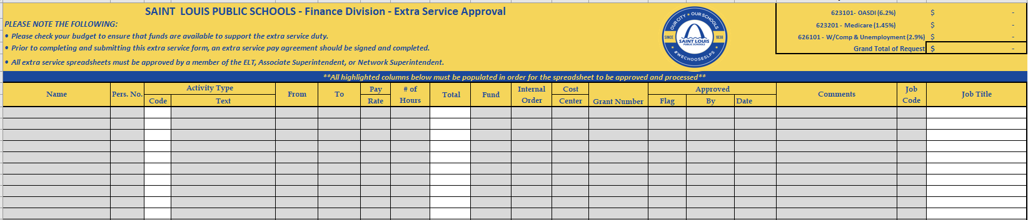
EXTRA SERVICE SPREADSHEET
The grey highlighted areas must be completed
Information on the spreadsheet must be confirmed and validated in SAP
Teacher information, such as Personnel Number and Job Code, can be found on the Staffing Roster from Human Resources provided to your Principal

Slide 18
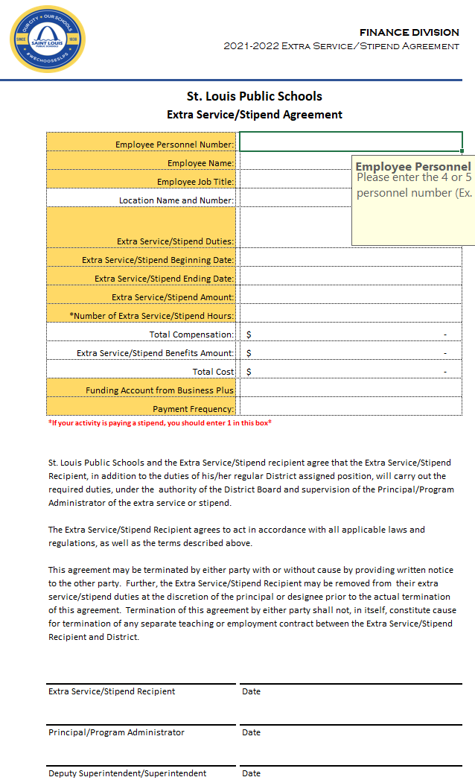
EXTRA SERVICE PAY AGREEMENT
ALL employees on the extra service spreadsheet must have a signed pay agreement
The pay agreements must have the actual signature of the employee and building principal

Slide 19
QUESTIONS

Slide 20
EXTRA SERVICE VALIDATON PROCESS
Send to the Payroll department to be processed
Spreadsheet & Signed pay agreement forms are filled out and approved by the Principal/Program Manager
Spreadsheet & Signed pay agreement are approved by Network Superintendent
Extra Service spreadsheet & pay agreements are sent to FinMgmtOfc@slps.org
for processing
Finance Analyst verifies that all information is correct and has the budget capacity to support the request
Send back to location to inform them of additional information needed
Once updated have been made, send to the Payroll department for processing

